Slide 1
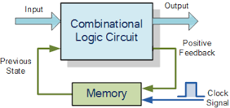
Sequential Circuit

Slide 2
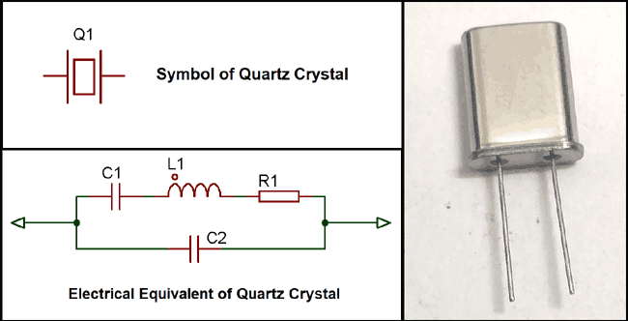
Clock

Slide 3
In such situation, the Quartz Crystal is used. Quartz is composed of silicon and Oxygen atoms.
Piezo-electric effect
When voltage source is applied across it, it will change shape and produce mechanical forces, and the mechanical forces revert back, and produce electrical charge so it is referred as Transducers.

Slide 4
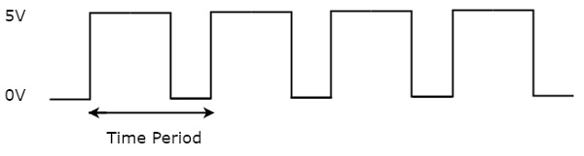

Slide 5
F = 1 / t
Where,
F is frequency and t is total time period
Duty Cycle = 50 %
=Signal / total time

Slide 6
Triggering type –
Level
Edge

Slide 7
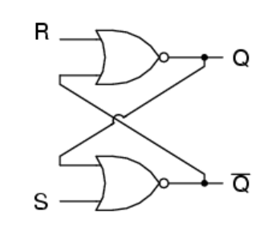
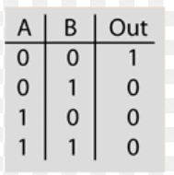
SR NOR Latch

Slide 10
Case 1 : S = 0 ,R= 1 , Q = & Q’ =
S= 0 ,R= 0 , Q = & Q’ =
Case 2 : S = 1 ,R= 0 , Q = & Q’ =
S= 0 ,R= 0 , Q = & Q’ =
Case 3 : S = 1 ,R= 1 , Q = & Q’ =
S= 0 ,R= 0 , Q = & Q’ =
Q = & Q’ =

Slide 11
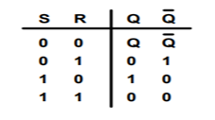

Slide 12
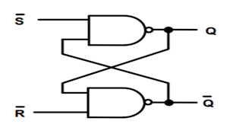
SR NAND Latch

Slide 13
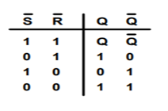
Truth Table :

Slide 14
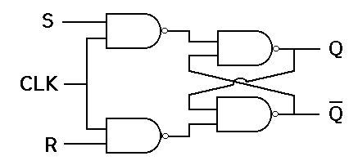
S-R Flip Flop

Slide 15
S* = (S.CLK)’ = S’ + CLK’
R* = (R.CLK)’ = R’ + CLK’

Slide 19
CLK | S | R | Q | Q’
0 | X | X | MEMORY
1 | 0 | 0 | MEMORY
1 | 0 | 1 | 0 | 1
1 | 1 | 0 | 1 | 0
1 | 1 | 1 | Not USED

Slide 20
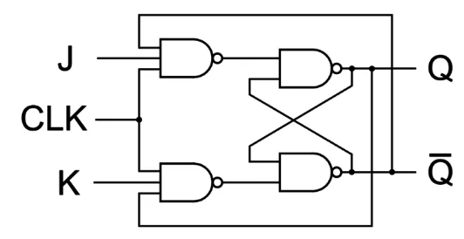
JK Flip Flop (Jack Kilby)

Slide 21
Case 1 : J = 0 ,K= 1 , Q = & Q’ =
J= 0 ,K= 0 , Q = & Q’ =
Case 2 : J = 1 ,K= 0 , Q = & Q’ =
J = 0 ,K= 0 , Q = & Q’ =
Case 3 : J = 1 ,K= 1 , Q = & Q’ =
J= 0 ,K= 0 , Q = & Q’ =
Q = & Q’ =

